Slide 1
BLUSH

Slide 2
CONCEPT
Cute platformer / puzzle game
You are a small thing travelling through an outdoorsy environment
Focus on a pleasing aesthetic / controls that feel nice
Mechanics: Run / Jump / Push

Slide 3
LEVEL 1 - Ant Stampede
Get over rock and jump into pit.
Player can explore the space and find that they can’t jump high enough to escape the pit (on either sides).
At a point in the pit there is an ant hill that the player will step on unknowingly. This will cause a “shake” as a form of feedback to let the player know that this has triggered a change.
As the player navigates back to the left they will encounter a swarm of ants that will chase them (ants will kill you on collision).
To Escape: The player must run to the leaf before the ants reach him. If they stay on the leaf the player will be picked up by the swarm and sufficiently lifted to escape the pit.
If they do not stay on the leaf the ants will kill them.
Note: The leaf will be taken with the ants under the ground so there is a shallow window of time to make the jump to safety.

Slide 4
LEVEL 2 - Flower Platformer
Below you is sludgy water. If you fall into it, you sink and die.
There are flowers and pieces of litter (that are swaying) growing out of this puddle.
The player must jump across successfully in order to arrive at the other side.
The weight of the player will bend the flowers making it so the amount of time spent on a platform path is time sensitive.
The last platform is a butterfly. Once you land on it, it will fly you to the next level.

Slide 5
LEVEL 3 - Uh-oh, Butterflies
The butterfly will fly you to a butterfly nest in a tree where a bunch of butterflies are suspended on branches. The player is perched on a branch at this point.
In order to move to the next level the player must jump from butterfly to butterfly.
As this is happening, butterflies are launching their tongues out passively in search for food.
If a butterfly's tongue makes contact with the player, they are dead.
The butterflies are “slippery”. If The player jumps on one it is not long before the butterfly will start to slip off it’s branch and fly away (because the weight of the player char is heavier than a still butterfly). If this happens, the player dies.
To Escape: Make it past all the butterflies without getting licked or falling off.
You have reached the end once you make it to a tall cliff that reaches the butterfly branch.

Slide 6
LEVEL 4 - Feet Are Trying to Kill You
As you proceed down the hill from the top of the cliff, you begin to hear / feel rumbling.
As you proceed you notice a pair of feet stomp down and are about to murder you.
There are crevices in the ground and under rocks that you have to use to avoid being stomped on. This is a matter of learning what elements are available to you to hide under as well as learning the patterns of the feet that are trying to murder you.
Once you make it to the end you have completed the game.

Slide 7
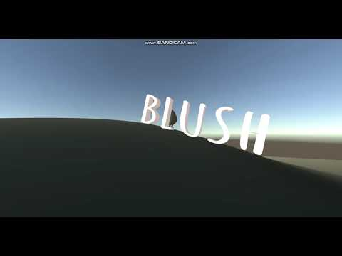

Slide 8
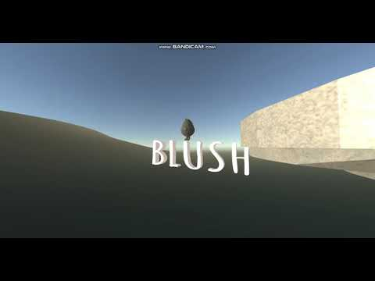

Slide 9
